Slide 1
Customer Retentions Presented by :- Ruchita Parmar

Slide 2
Contents
Problem statement and understanding.
EDA steps and visualizations.
Assumptions used to complete the project, analysis.
Conclusion.

Slide 3
Problem Statement & Understanding
Many companies think that marketing is all about selling of products and how the company will increase its profitability in the market share and not considering after sales service to be able to know whether the customers are satisfied with the products are able to use it. The main problem is ‘what kind of strategies is expected from telecommunication industries to be able to retain their customers?’
Background of the study
Customer retention is defined as reduction of customer defection. A continuous customer contact with any if all possible means is an important aspect. To attract and retain new customers is strongly related to the offered services and product. Exceeding the customer expectations make them loyal to the Brand. Reduction in market share and profit needs to be stopped.

Slide 4
Problem Statement & Understanding
Objective
To Identify and Examine the Challenges
To identify customer retention strategies and policies
Significance of the study
To implement right retention strategies
Scope and limitations
Scope of Customer Retention is one of the foremost benefit offered by customer retention as companies do not need to run mass wide marketing campaigns. Serving the present customer base effectively is cheaper for business in comparison to acquiring new customers.

Slide 5
problem statement and understanding
Customer satisfaction guarantees e-commerce success with stimulant of customer retention with purchase, repurchase, intentions and their loyalty.
There were few major factors directly proportional to enhance the quality for customer's retention.
Identify customer who are at risk of defecting
Remediation & Views
Questionnaires or Surveys
Premiums and Gifts
Coupons on renewal
Remorse resolution
Cross-Selling & Up-Selling

Slide 6
Points that affect :-
Preferred payment Options :- Maximum people purchase by debit and credit card so payment option should be appropriate.
Missing or Unclear Product Information :- When you introduce a product to your would-be customers, you can break down the information into two basic categories: product features and product benefits.
The solution: make sure to include all available information on the product page, including frequently asked questions.
The Lack of Personalization :- If you provide a personalized shopping experience, you have a much better chance of converting your visitors to customers, simply because you can show them products they are actually interested in instead of showcasing your entire product range.
The solution: personalize as much as you can – even on search result pages.

Slide 7
Lack of Security and Privacy Leaks:- There are few events that are more damaging to online retailers than data leaks. Every year there are thousands, if not millions of these, ranging from small e-Commerce sites being hacked by backdoor-exploiting bots to large scandals.
Solution: never sell products without offering a guarantee – it will seem suspicious
and plant uncertainty in the would-be customer’s mind.
Additional charges :- The first universal reason behind cart abandonment: it’s when users at the end of a check-out process are faced with unexpected, or unexpectedly high charges.
solution: Always display the full price, and include tax and all additional prices in it indicate the shipping prices throughout the process, not only at the check-out. And don’t have any hidden charges.
Long Delivery :- When we look at shipping, price is important (and communicating it properly is even more so), but shipping time are also a major concern.
Solution: if a customer knows how many days are left until their package arrives when it will be delivered, where it currently is, they are much more likely to be satisfied with this purchase and become repeat customers.

Slide 8
Too Complex Check-out process :- The third most common reason – after high/unexpected prices and forced account creation – people abandon their cart is that the checkout process is too complex.
Solution: Tailor your check-out process for the needs of the customer – for
simple products, provide simple check-out.
Return policy:- Just as with guarantees, the only reason for not making your return policies as flexible as they can be is if you don’t trust your own product. Solution: make your return policy as flexible as you can. If your product and services are reliably good, you will rarely ever have to handle returns.

Slide 9
EDA steps and visualizations
Data visualization is easy to perform EDA which makes it easy to make others understand our analysis.
Lets start with understanding of Data which directly guide the business for the customers retentions with below steps.
How often customer visiting & switching E-Commerce portal.
When they were visiting like any festive seasons.
Are they looking for Brand products, offers, discounts, etc.
Are they recommending product reviews before finalization.
Preferred mode of payment CoD, debit or credit card, online, UPI, any wallet.
Why did they switching from their first choice product or brand and ordering other available options after comparisons.
Are they looking for any specific sellers
Level of concerned of their personal information i.e Privacy.
What they prefer between Early delivery, best price, quality, reviews, recommendations.

Slide 10
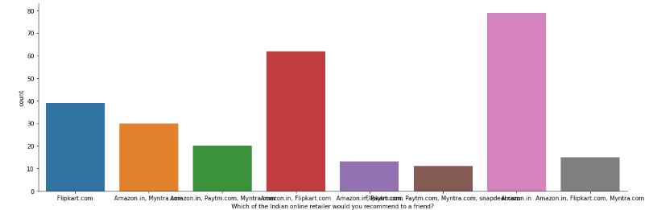
EDA steps and visualizations

Slide 11
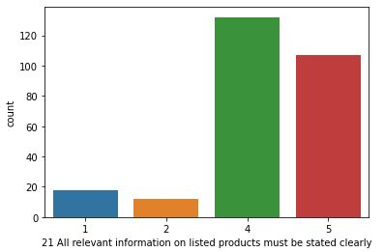
EDA steps and visualizations

Slide 12
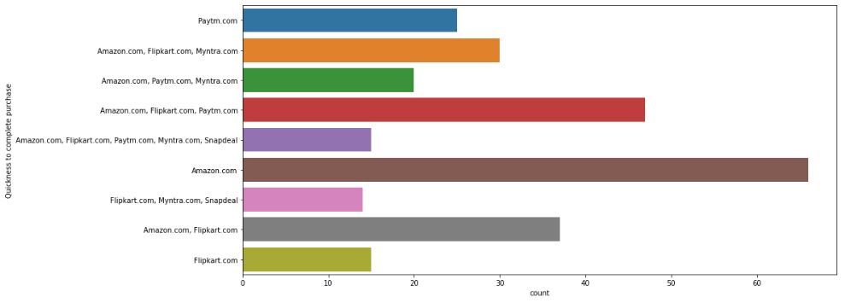
EDA steps and visualizations
Below graph is showing quickly customer is able to complete their purchase

Slide 13

Assumptions Customer retentions goal is to increase revenue and want them to buy more & spend more.

Slide 14

conclusion
Retention’s conclusion is about keeping your current consumers happy, so as they feel more convenient to stay with us than to buy from a competitor.
Hopefully the Strategies above will enlighten us with new ideas to approach the goal of Customer Retention.

